Slide 1


BE Project Final Presentation On “Automated Web & Video Summarization Tool Using NLP.”
NBN Sinhgad School of Engineering Department of Information Technology
Presented by
Shubham Mahale 72219381F
Amit Raut 72158896E
Nikhil ingle 72219379D
Shivam Chincholkar 72158717J
Guided By
Prof. R. M. Samant.
Prof. Urvashi Bhat.

Slide 2
Outline
Introduction
Motivation
Objectives
Problem Statement
Literature Survey
Proposed Methodology
Technologies used
Proposed Algorithm
Design
Results
Comparison Table
Analysis
Conclusion
Future Scope
References

Slide 3
Introduction
The project "Automated Web & Video Summarization Tool Using NLP" aims to alleviate the challenges posed by the influx of web & video content by employing advanced Natural Language Processing techniques.
Influx of Content: The digital landscape is witnessing an exponential increase in web & video content across diverse domains, such as education, entertainment, and business. There is not only increase in number of contents but also in the size of the content.
Need of Summarizer: To address these challenges, our project aims to develop an automated tool that utilizes Natural Language Processing (NLP) techniques to generate concise and coherent summaries from web content & video transcripts.

Slide 4
Motivation
Motivation Behind Developing Automated Web & Video Summarization Tool Using NLP :
Information Overload: In today's digital landscape, the vast amount of web and video content overwhelms users, making it challenging to extract relevant information efficiently.
Time Constraints: Manual web & video content consumption requires substantial time, which clashes with busy schedules and the need for quick information retrieval.
Inefficient Manual Extraction: Traditional methods of watching and manually extracting information from videos are labor-intensive and fail to cater to the need for swift insights.
.

Slide 5
Objectives
To implement advanced Natural Language Processing (NLP) techniques to automatically generate concise summaries from web content & video transcripts.
To designing an extension that allows easy and on-place input of web & videos and retrieval of summarized content.
To incorporate automated translation capabilities to facilitate summarization of web content & video transcripts in different languages.
To introduce a read aloud tool for users who prefer listening over reading.

Slide 6
Problem Statement
In the modern digital era, the abundance of online web & video content has created a flood of information, making it difficult for users to efficiently extract insights from lengthy videos and web content. Manual extraction is time-consuming and ineffective, prompting a demand for automated solutions. By utilizing Natural Language Processing (NLP), automated web and video summarization tool offers a swift way for users to identify crucial information and patterns without watching the entire video.

Slide 7
Literature Survey
Sr. No. | Title of paper | Author | Year of publication | Proposed work | Gap
1. | "YouTube Transcript Summarizer Using Flask and NLP." (JPSP) | P. Vijaya Kumari, M. Chenna Keshava, C. Narendra, P. Akanksha, K. Sravani. | April 2022 | Author employed an interface with Flask-based backend server powers a YouTube transcript summarization system with user-friendly features like translation, speech synthesis, downloads, and email sharing. | This paper proposed a system in which user has to switch the tab and paste the YouTube video link on website. However, this extra work can be avoided by embedding this technology in browser-based extension.
2. | “Text Summarization using NLP”, (IJTRET) | Chetana Varagantham, J. Srinija Reddy, Uday Yelleni, Madhumitha Kotha, P. Venkateswara Rao | August 2022 | Author presents a framework for Extractive Text Summarization. The proposed framework depends on summarizing the text using K-means clustering algorithm where clusters based upon sentences score. | In this paper, author proposed system which creates extractive summarization by providing text location. But abstractive summarization provides more insights on information.

Slide 8
Sr. No. | Title of paper | Author | Year of publication | Proposed work | Gap
3. | “AI-based Video Summarization using FFmpeg and NLP.” (IJISRT) | Hansaraj Wankhede, R Bharathi Kumar, Sushant Kawade, Ashish Ramtekkar, Rachana Chawke | April 2023 | The author proposed an AI-based video summarization platform which creates the summaries of the provided videos by using FFmpeg and NLP techniques. | In this paper, author proposed a system which provide summary of video which is given as input. However, giving video as input requires more time and fast internet. This can be resolve by generating summary of online uploaded videos.
4. | “Review of Text Summarization Techniques of Documents”, (IJCRT) | Shubham U. Pawar, Om S. Behare, Sumit D. Umap, Akshay K. Adhav, Bhushan B. Pawar, Ram S. Thakare, Prof. Harshada M. Raghuvanshi | March 2023 | The author presents a system that creates extractive summary of the text using python NLTK library and pretrained deep learning AI model Bidirectional Encoder Representations from Transformers which was released by Google AI language researchers. | Author proposed system which creates extractive summarization of provided text document. But as previously discussed abstractive summarization is better approach.

Slide 9

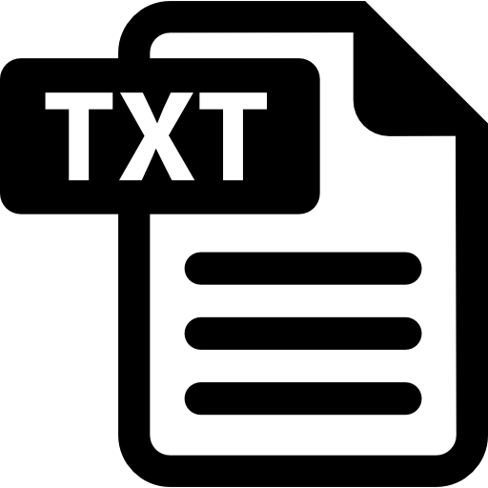
Proposed Methodology
This paper proposes a system, that is a browser-based extension which summarizes any web or YouTube video available on World Wide Web. This is a Flask based application which gives call to summary API created using Flask, which provides user with summary as output.
YouTube video text extraction module:
To generate summary we need mechanism which can extract text from YouTube videos. For that purpose, we used the pytube library of python for extracting audio from the videos. Then, Assembly AI is used to convert this audio into text.
Fig. 1 YouTube video to text

Slide 10

Web scraping module:
Scraping data from the webpages available on the internet is the most challenging part. So, proper mechanism is needed to automatically scrape the web content. The BeautifulSoup is the python library which is used for scraping data by parsing HTML document. Extracted text is saved in .txt file.
Fig. 2 Web Scraping
Summarization module:
There are different methods available by which summary can be generated. Extractive and Abstractive are two types of text summarization. Both ways have their benefits as well as limitations. Abstractive summarization generates new sentence from two or more existing sentences from original text. . The proposed system generates the abstractive summaries of the text or video. The proposed system uses text rank algorithm

Slide 11


Translation module
There are some users who prefer to read summary in their preferred language. So, translation module uses GoogleTranslator API for translating the generated summary in different languages as per user’s preference.
Read Aloud module
Also, there are some users who prefer to listen rather than to read the summary. For such users, read aloud module is introduced. The SpeechSynthesisUtterance library of JavaScript is used.
Fig. 4 Translation
Fig. 5 Read aloud

Slide 12
Technologies Used
Programming Languages:
Python, HTML, CSS, JavaScript.
Libraries and Frameworks:
Flask, BeautifulSoup, pytube.
APIs:
AssemblyAi, DeepTranslator.

Slide 13
Proposed Algorithm
User initiates the summarization process by clicking on the "summarize" button.
The URL of the web page URL is transmitted from the client-side (browser) to the server for analysis.
The server identifies whether the content linked is text-based (web article) or video-based (YouTube video).
If the content is a video:
The server extracts the audio from the video.
This audio is then transcribed into text format.
The resulting text is forwarded for further summarization.
If the content is text-based:
The text is directly forwarded for summarization.
Utilizing various NLP techniques, the server generates a summary from the provided text.
The generated summary is displayed to the user through the browser-based interface.

Slide 14




System Architecture
Google Translator
API
USER
INTERFACE
SERVER
Speech Synthesis Utterance

Slide 15
DFD-Level 0
Server
User
Asks for summarization
Displays Summary

Slide 16
DFD-Level 1
Summarize
Read
Server
User
Returns
Translate

Slide 17
DFD-Level 2
Summarize
Speech Synthesis utterance
API
Read
Server
User
Returns
Translator API
Translate

Slide 18
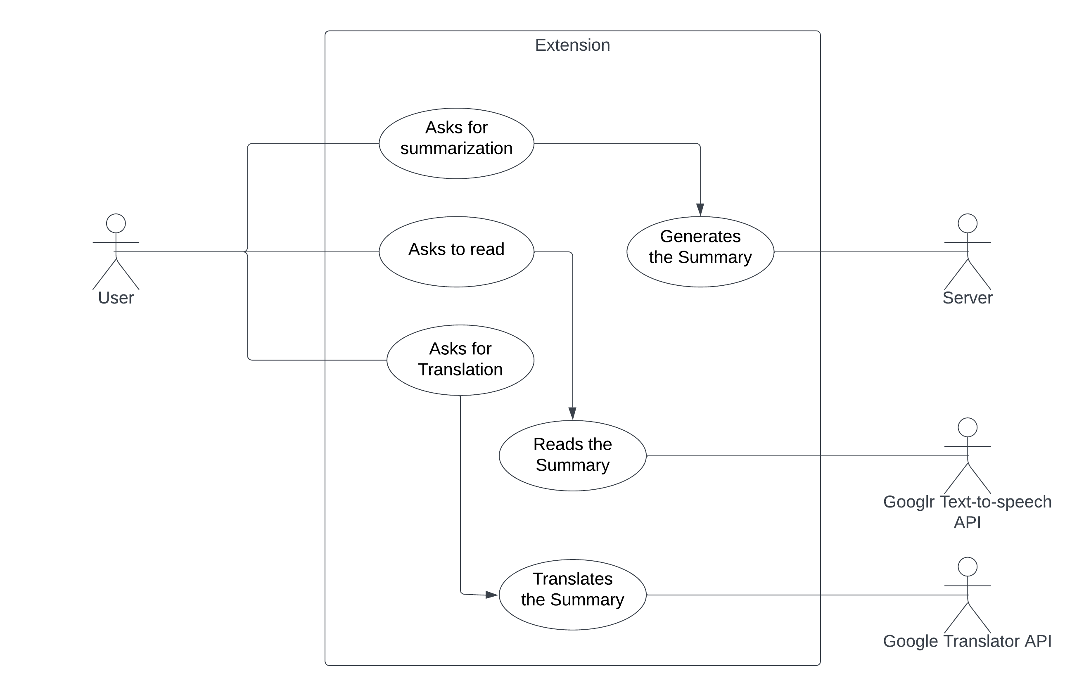
Use Case
Speech Synthesis utterance

Slide 19
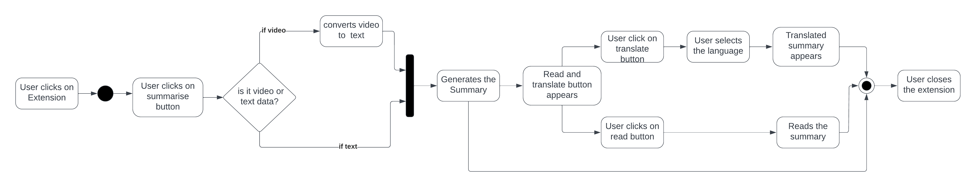
Activity Diagram

Slide 20
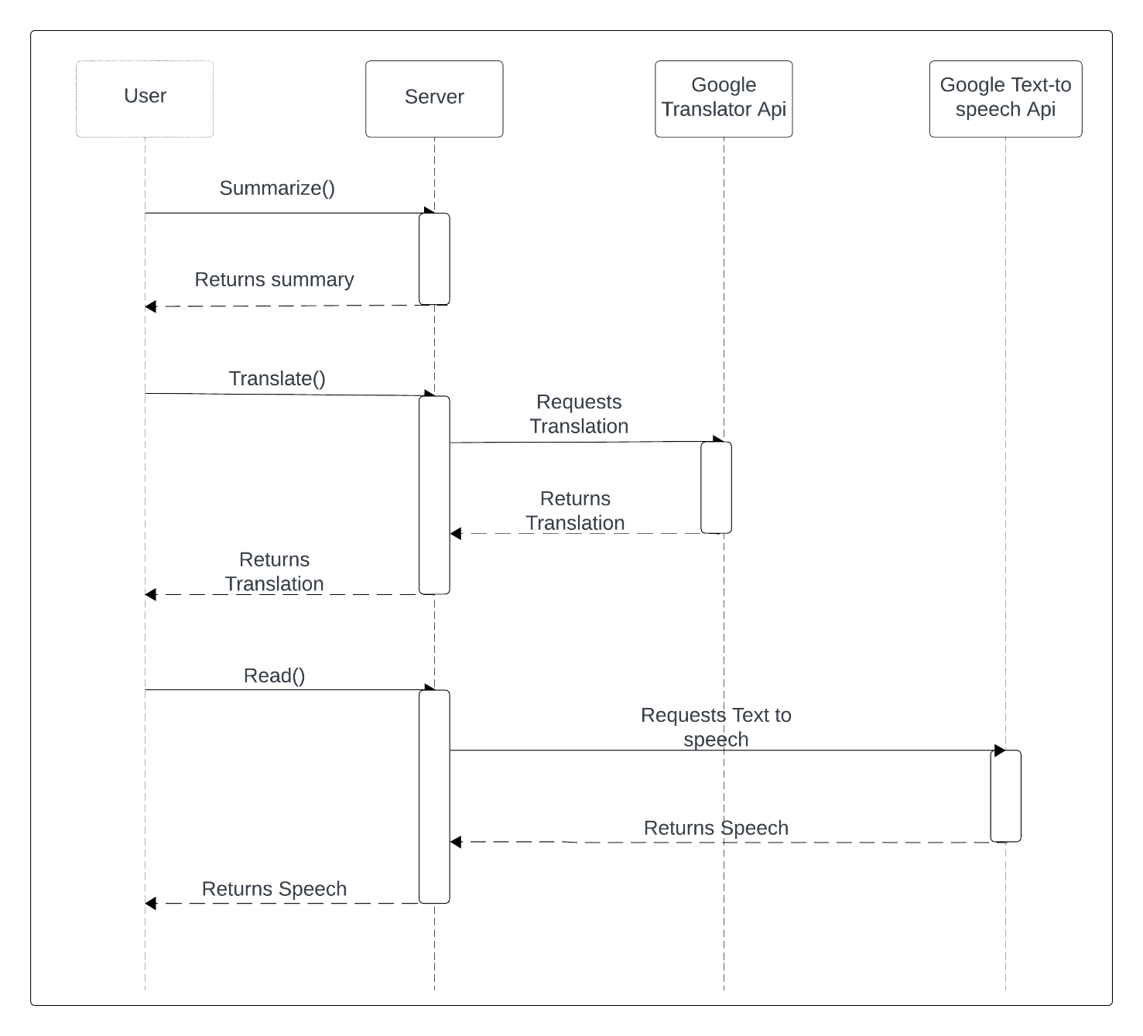
Sequence Diagram
Speech synthesis utterance

Slide 21
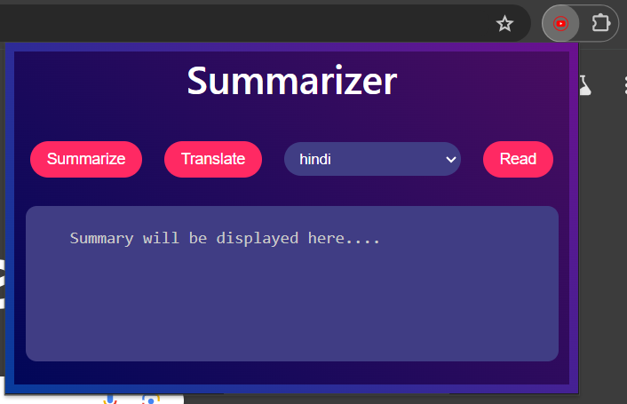
Results
User Interface :

Slide 22
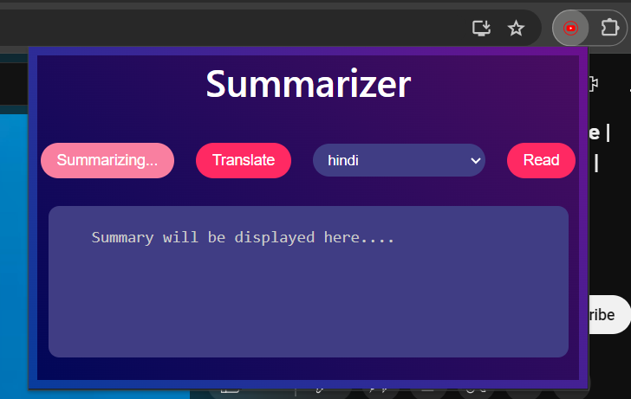
During Summarization :

Slide 23
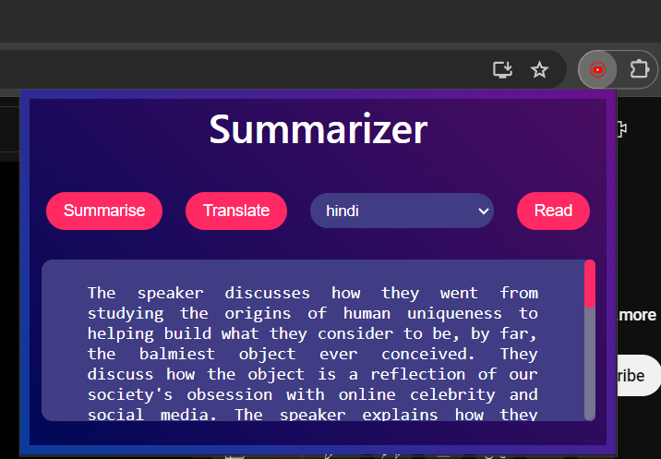
After Summarization :

Slide 24
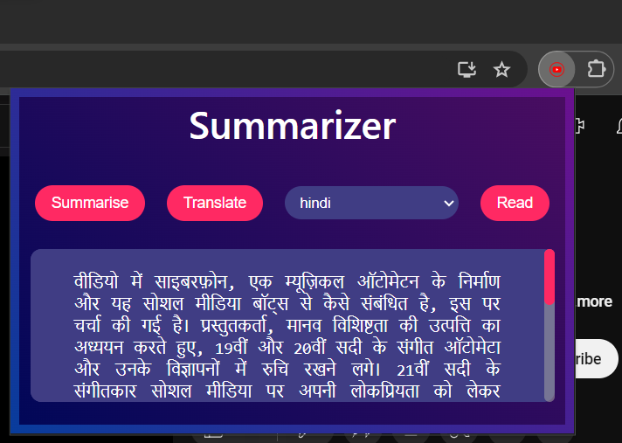
After Translation :

Slide 25
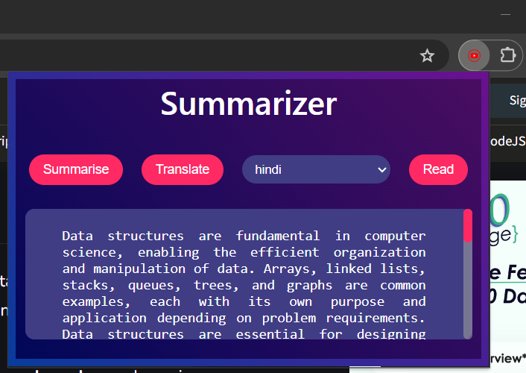
Web Summarization :

Slide 26
Comparison Table
Reference paper | Model Accuracy | Translation support | Read aloud support | Extension | Web-content summarization | YouTube Video Summarization
Proposed System | 84.41% | Yes | Yes | Yes | Yes | Yes
Vijaya et al. (2022) [1] | 55.63% | Yes | Yes | No | No | Yes
Varagantham et al. (2022) [2] | 69.42% | No | No | No | Yes | No
Wankhede et al. (2023) [3] | 82.00% | No | No | No | No | Yes
Bhandare et al. (2022) [4] | 69.42% | No | No | No | Yes | No

Slide 27
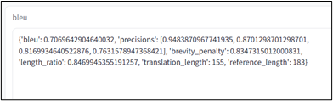
Analysis
The BLEU (BiLingual Evaluation Understudy) score is calculated by comparing machine generated summary with human generated summary. The score of which is near to the 1, that summary is considered to be of good quality. When BLEU score was calculated for our system, the system achieved BLEU score of 0.7069. Which is considered as good quality for summarization.

Slide 28
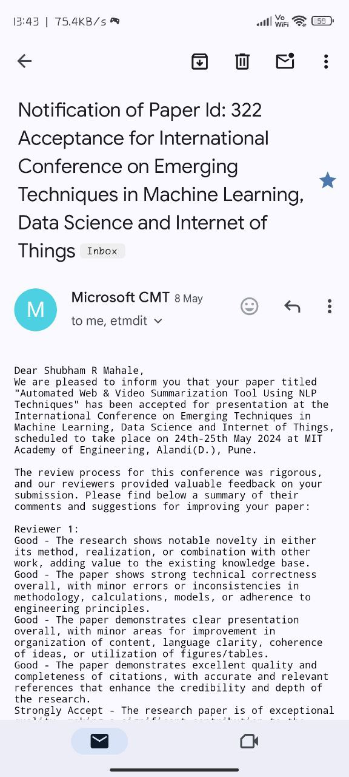
Published Paper

Slide 29
Conclusion
The "Automated Web & Video Summarization tool using NLP" project addresses the modern challenge of information overload in web & video content.
By using the power of Natural Language Processing, the project streamlines information extraction, enhances accessibility, and empowers users to make informed decisions swiftly.
This project contributes to time efficiency, inclusivity, and improved content creation, reflecting the dynamic intersection of technology and practical utility in today's digital landscape.

Slide 30
Future Scope
The "Automated Web & Video Summarization Tool Using NLP" project holds immense potential for future expansion and enhancement. It can further diversify its impact by extending support for multiple languages and incorporating content from various sources, such as social media, academic journals, and audio content. Offering users, the ability to customize summarization preferences, including summary length and style, can personalize the experience. The future scope for this project is expansive, promising to keep it at the forefront of content summarization technology and a valuable resource for users across diverse domains.

Slide 31
References
Kumari, P. Vijaya, M. Chenna Keshava, C. Narendra, P. Akanksha, and K. Sravani. "YouTube Transcript Summarizer Using Flask and NLP." Journal of Positive School Psychology 6, no. 8 (2022): 1204-1209.
Chetana Varagantham, J. Srinija Reddy, Uday Yelleni, Madhumitha Kotha, P. Venkateswara Rao. “Text Summarization using NLP”, International Journal of Trendy Research in Engineering and Technology, Volume 6, Issue 4, August 2022, ISSN NO 2582-0958.
Hansaraj Wankhede, R Bharathi Kumar, Sushant Kawade, Ashish Ramtekkar, Rachana Chawke. “AI-based Video Summarization using FFmpeg and NLP.” International Journal of Innovative Science and Research Technology Issue- 4, April – 2023.
Pradeepika Verma and Anshul Verma, “A Review on Text Summarization Techniques”, Journal of Scientific Research, Volume 64, Issue 1, 2020.
Sanjana R, Sai Gagana V, Vedhavathi K R, Kiran K N,” Video Summarization using NLP”, International Research Journal of Engineering and Technology (IRJET) Issue: 08 | Aug 2021.

Slide 32
S. Tharun, R. Kranthi Kumar, P. Sai Sravanth, G. Srujan Reddy, B. Akshay,” Survey on Abstractive Transcript Summarization of YouTube Videos”, International Journal of Advanced Research in Science, Communication and Technology (IJARSCT) Issue-2, April 2022.
Shubham U. Pawar, Om S. Behare, Sumit D. Umap, Akshay K. Adhav, Bhushan B. Pawar, Ram S. Thakare, Prof. Harshada M. Raghuwanshi, “Review of Text Summarization Techniques of Documents”, International Journal of Creative Research Thoughts (IJCRT), Volume 11, Issue 3 March 2023 | ISSN: 2320-2882.
Kavita Namdeo Jadhav, “An Analysis of Text Summarization Approaches using Natural Language Processing”, International Journal of Ingenious Research, Invention and Development, Volume 1, Issue 2, February 2023.
Chetana Varagantham, J. Srinija Reddy, Uday Yelleni, Madhumitha Kotha, Dr P. Venkateswara Rao, “Text Summarization using NLP”, Journal of Emerging Technologies and Innovative Research (JETIR), May 2022, Volume 9, Issue 5.
Gousiya Begum, N. Musrat Sultana, Dharma Ashritha, “YouTube Transcript Summarizer”, International Journal of Creative Research Thoughts. Volume 10 Issue 6 June 2022.

